Slide 1
BOT PERFORMANCE ANALYSIS AND IMPROVEMENTS

Slide 2
Idea Abstract & Objectives
Idea Abstract : This project aims to analysis historical performance data of a bot using Pyspark Core , SQL and MongoDB. This analysis will help identify trends , optimize bot responses , and enhance user experience.
Objectives:
Collect and process historical bot interaction data.
Analyze bot performance and user behavior using SQL.
Identify trends and changes over time.
Visualize key metrics and trends.
Implement predictive analytics for future bot performance and user interactions.

Slide 3
Technologies
PySpark Core: For data processing and transformation.
SQL: For complex data analysis and querying.
MongoDB: For data storage and querying.
Power BI: For data visualization and reporting.
Python: For data manipulation and machine learning.

Slide 4
USER STORY 1
As a data analyst, I want to clean and preprocess raw bot data using PySpark, so that the data is accurate, consistent, and ready for analysis.
Solution developed:
We used PySpark to clean and preprocess raw bot data for accuracy and consistency.
Key steps included handling null values, removing duplicates, and filtering invalid entries.
Data types were standardized, and fields were normalized for uniformity.
This resulted in a clean, analysis-ready dataset optimized for performance.

Slide 5
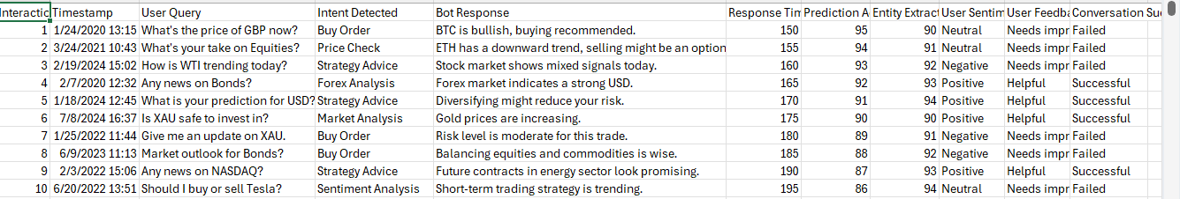
DATASET (TRADING 1000 RECORDS)

Slide 6
USER STORY 2
As a data engineer, I want to store processed data in MongoDB, so that it can be efficiently queried and reused for future analysis.
Solution developed:
We stored the processed data in MongoDB to enable efficient querying and future reuse.
A MongoDB collection was created to hold the cleaned bot data as structured documents.
Each row in the dataset was mapped to a document with clearly defined attributes.
This structure supports flexible querying and indexing for fast data retrieval.
The approach ensures scalability and seamless integration with downstream analytics tools.

Slide 7
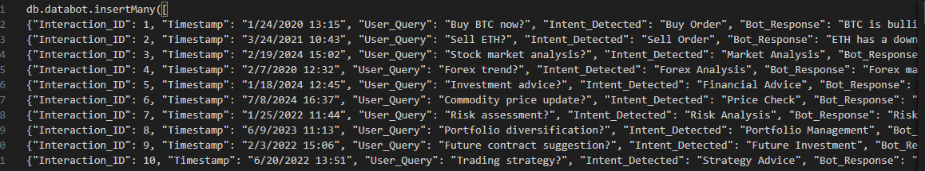
MONGODB TUPLES

Slide 8
USER STORY 3
As a data analyst, I want to write complex queries and aggregations on MongoDB or PySpark, so that I can analyze user behavior and bot performance.
Solution developed:
We utilized the MongoDB collection containing processed bot data for in-depth analysis.
Complex queries and aggregation pipelines were written to extract meaningful insights.
These queries helped analyze user behavior patterns and identify key interaction trends.
We have also written the queries in PySpark by creating rdd’s .
Groupings, filters, and time-based aggregations were used to monitor bot performance.
This enabled data-driven decisions to optimize the bot's effectiveness and user engagement.

Slide 9
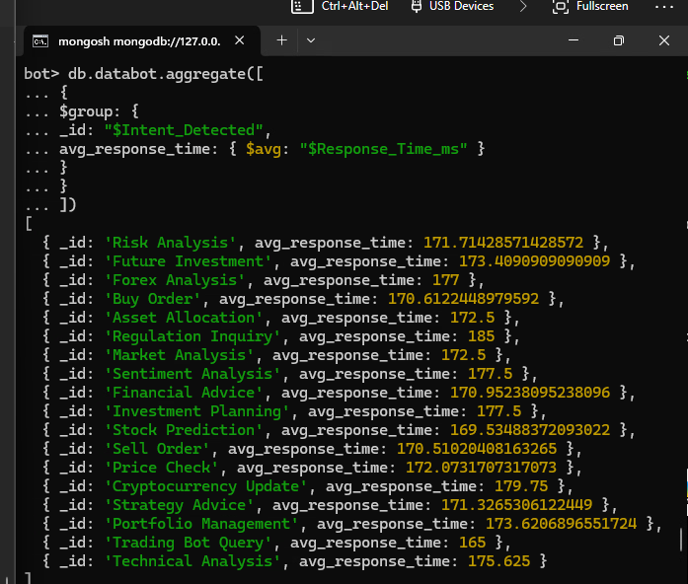
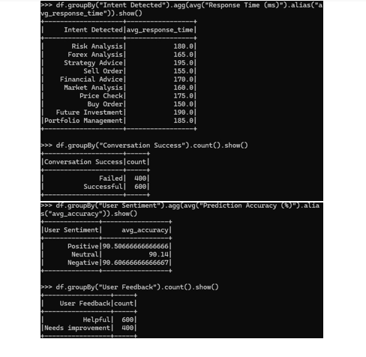
USER STORY 3(MONGODB & PYSPARK EXECUTION)
MONGODB QUERIES EXECUTION
PYSPARK QUERIES EXECUTION

Slide 10
USER STORY 4
As a product owner, I want to define key performance metrics such as response time, success rate, and user drop-off points, so that we can objectively evaluate the bot's performance.
Solution developed:
To meet the goal of objectively evaluating the bot's performance, we defined key performance metrics such as average response time, success rate, and user drop-off points. These metrics were derived from complex MongoDB queries written in the previous user story. The extracted data provided a solid foundation for analyzing how users interact with the bot, where they face issues, and how effectively the bot handles various scenarios.
We visualized these metrics using Power BI, creating interactive dashboards that offer a comprehensive and real-time view of bot performance. These visualizations help product owners and stakeholders quickly grasp complex trends, identify problem areas, and make data-driven decisions. By presenting the data in a clear and accessible format, the solution fully supports the user story’s goal—enabling an objective, insightful evaluation of the bot's effectiveness and guiding strategic improvements.

Slide 11
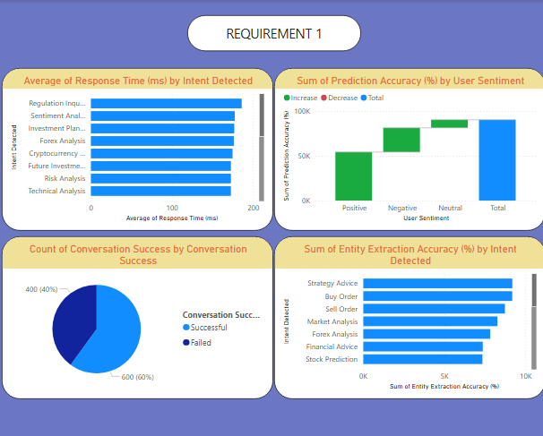
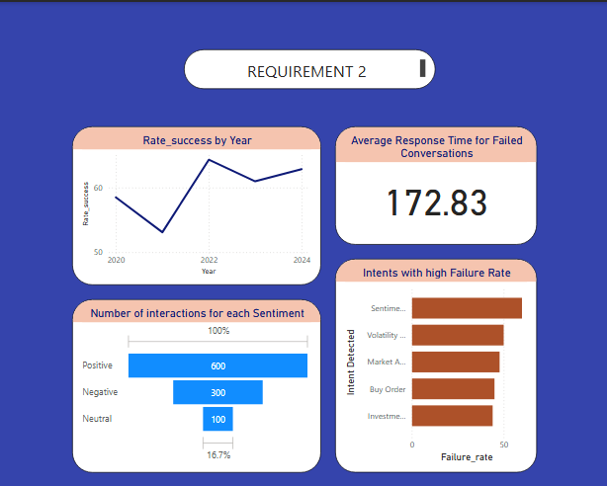
Power BI (4.1,4.2)

Slide 12
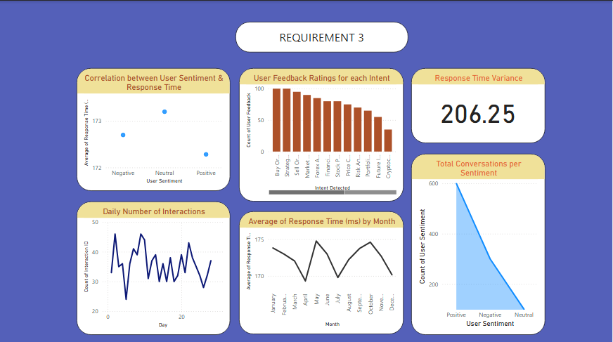
POWER BI (4.3)

Slide 13
USER STORY 5
As a data analyst, I want to identify trends and changes in bot performance over time, so that we can understand what factors affect user satisfaction.
Solution developed:
PySpark: PySpark was utilized to process raw bot data and compute key performance metrics necessary for analysis. Its powerful distributed computing capabilities allowed us to efficiently handle large volumes of data, clean it, and calculate metrics like average response time and success rates. This preprocessing with PySpark ensured accurate and consistent metrics for evaluating bot performance over time.
Power BI: Power BI was used to create detailed visualizations that track bot performance metrics over time. It offers interactive dashboards where users can analyze response times, success rates, and error rates across various time intervals such as daily, weekly, and monthly. These visual insights help stakeholders understand performance trends and make data-driven decisions to improve the bot’s effectiveness.

Slide 14
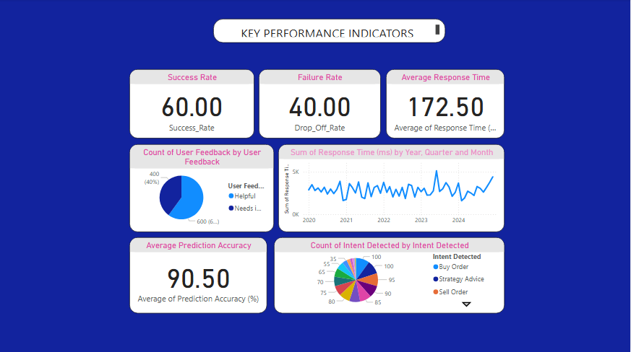
POWER BI (5.1)

Slide 15
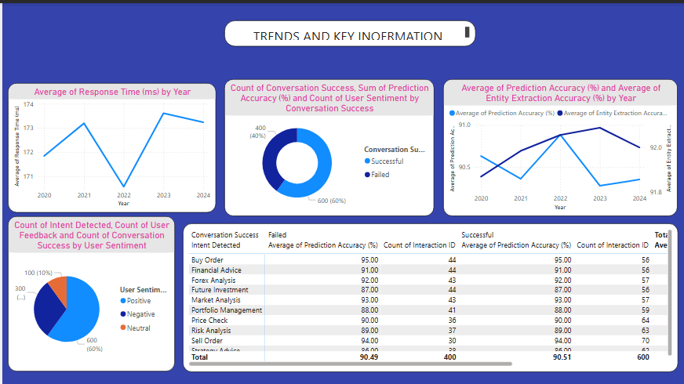
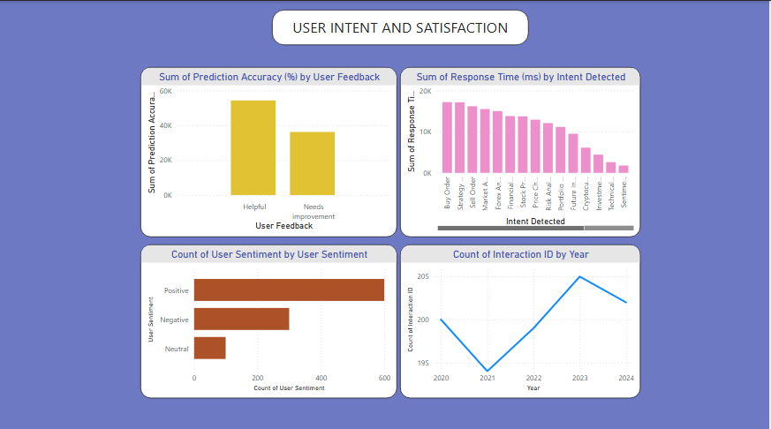
POWER BI (5.2,5.3)

Slide 16
THANK YOU
Jagadeesh Mouli Jyothula S V
Gandi Hima Varshini
Dumpala Devishree
Dipti Mondal
Subbisetti Teja

